Slide 1
Programming Contest Control PC^2 9.4.1 完整教學文件
BigMMS Lab
Department of Computer Science and Engineering
Yuan Ze University, Taoyuan, Taiwan

Slide 2
Outline
Introduction
Server
Initialization
Administrator
New account
New problem
Set Contest time
Judge
Auto judge
Team
Login
Scoreboard
Web

Slide 3
Introduction
Account | Description
Server | 管理考場
Administrator | 新增題目、帳號
Judge | 批改程式碼
Team | 供學生上傳程式
Scoreboard | 記分板

Slide 4
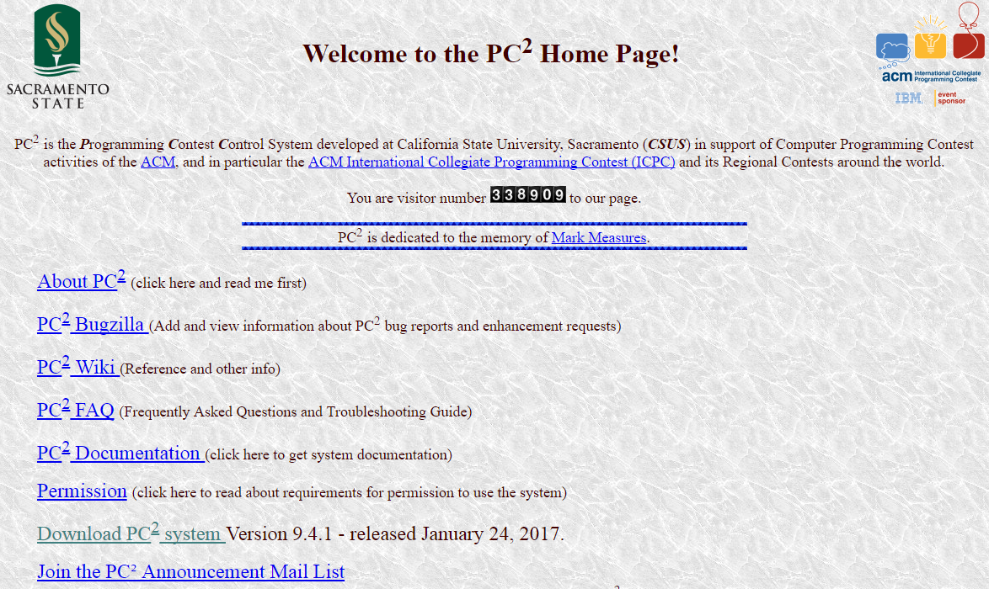
Introduction
進入下載頁面

Slide 5
Introduction
進入PC^2官方網站: https://pc2.ecs.csus.edu/

Slide 6
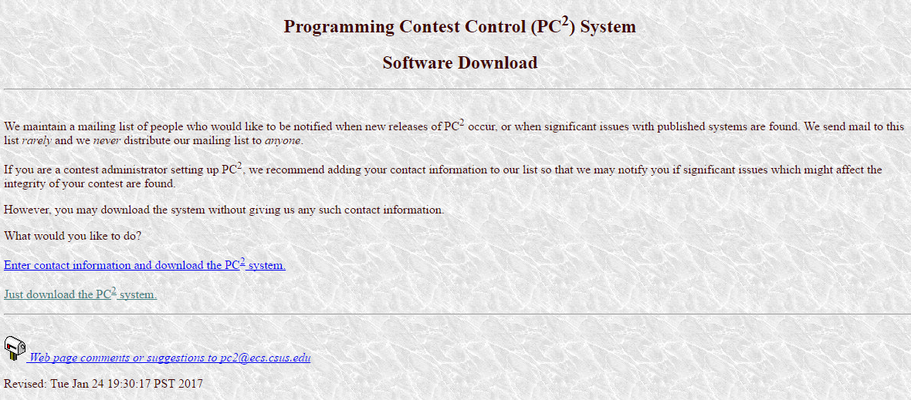

Introduction
$${PC}^{2}$$
選擇Just download the system

Slide 7
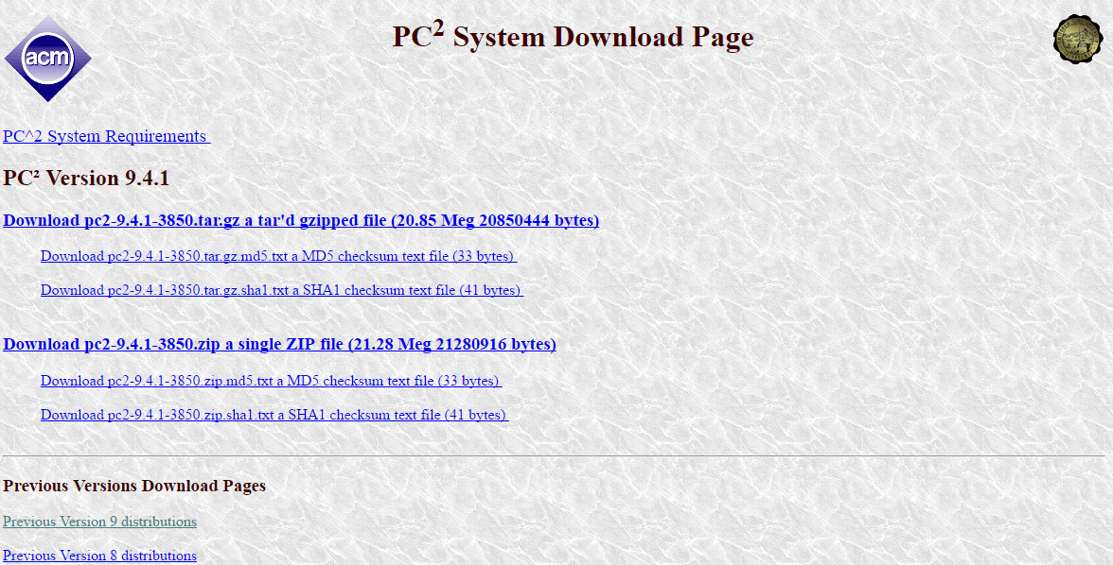
Introduction
下載pc2-9.4.1-3850.zip

Slide 8
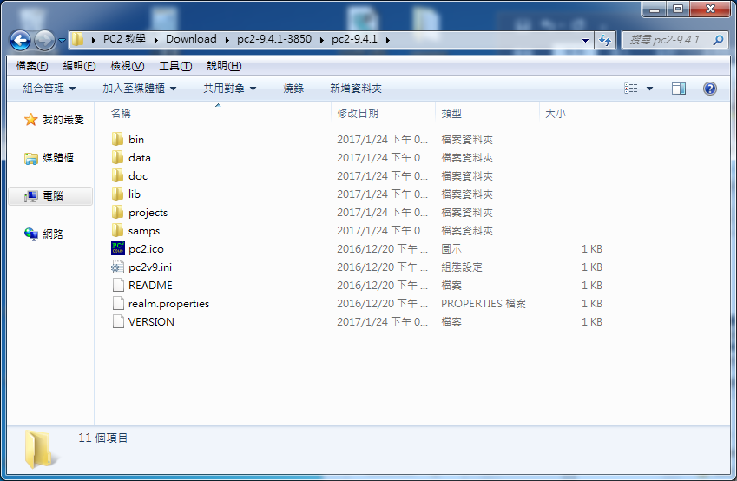
Introduction
Unzip pc2-9.4.1.zip

Slide 9
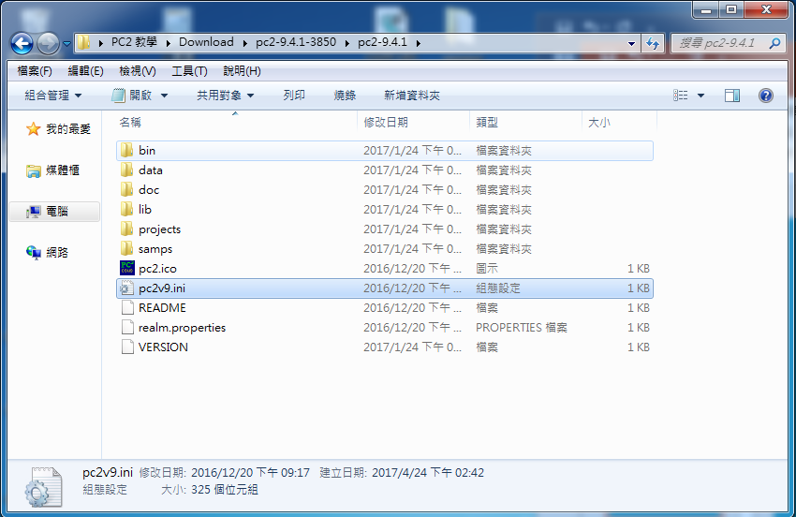
Introduction
將pc2v9.ini檔案直接移至到bin資料夾

Slide 10
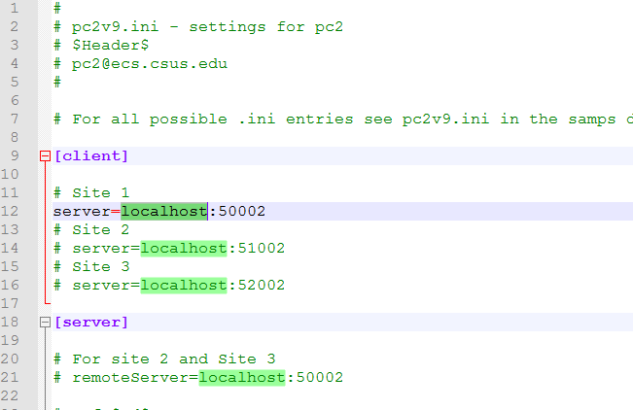
Introduction
Open pc2v9.ini

Slide 11
Introduction
Server : localhost
Client : Change to server’s IP

Slide 12
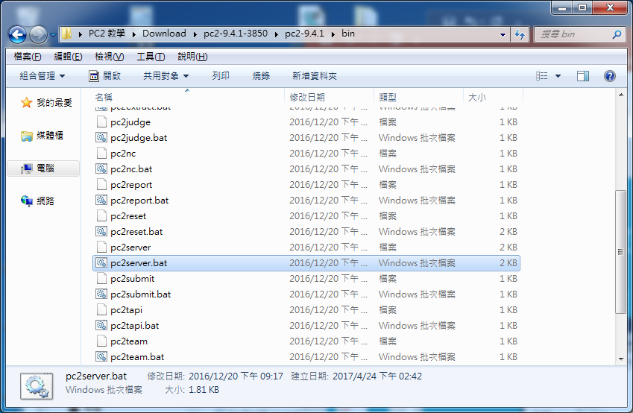
Server
Windows : Double click pc2server.bat
Linux : sh pc2server

Slide 13
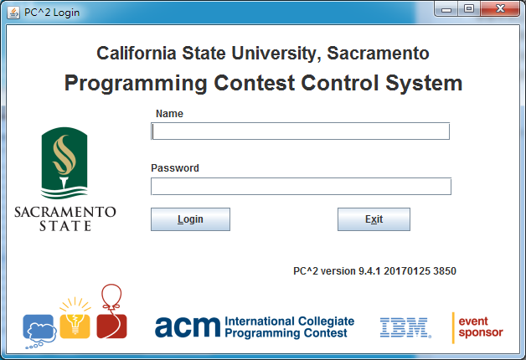
Server
Default Name : site1 Passwd : site1

Slide 14
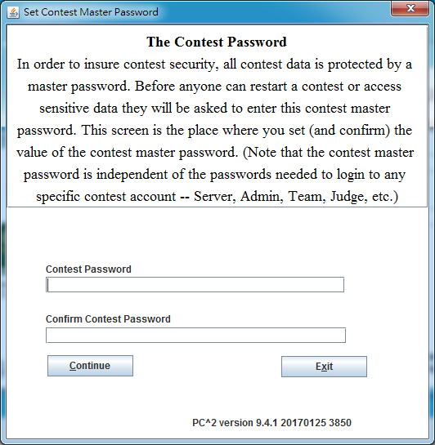
Server
Create Contest Password

Slide 15
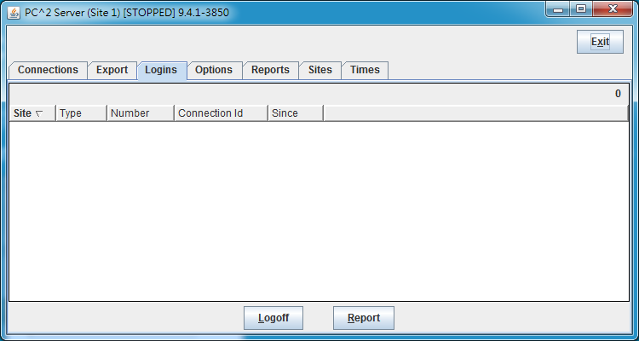
Server
Connections
Export
Logins
Options
Reports
Sites
Times

Slide 16
Server
Operation | Description
Connections | 檢視所有連線帳號
Export | 輸出Server資料
Logins | 查看目前登入帳號
Options | 查看log與變更Server密碼
Reports | 狀況回報
Sites | 比賽資料
Times | 比賽時間

Slide 17
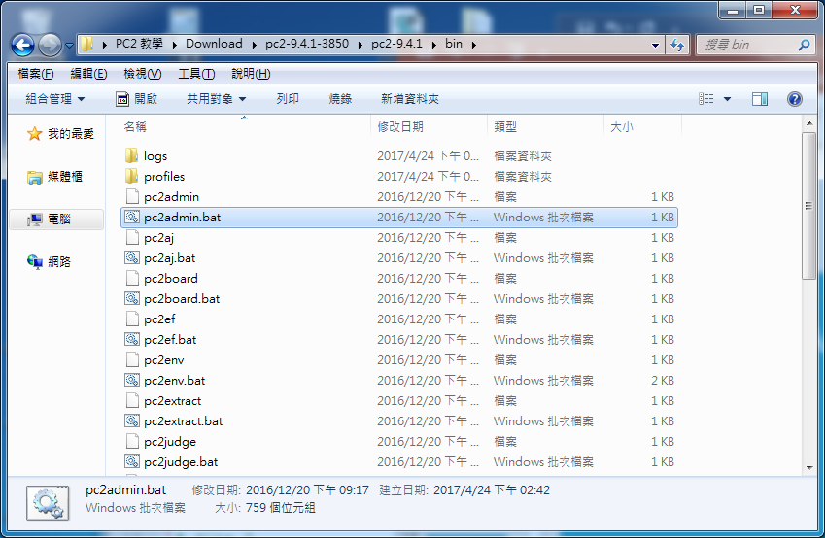
Administrator
Windows : Double click pc2admin.bat
Linux : sh pc2admin

Slide 18
Administrator
Default Name : root Passwd : administrator1

Slide 19
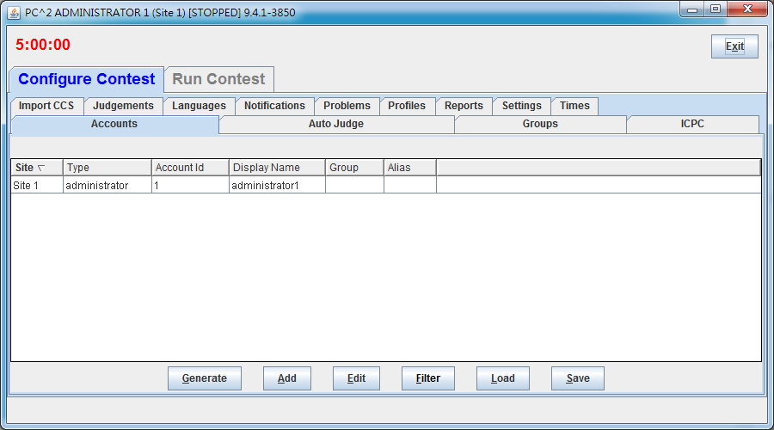
Administrator
New account

Slide 20
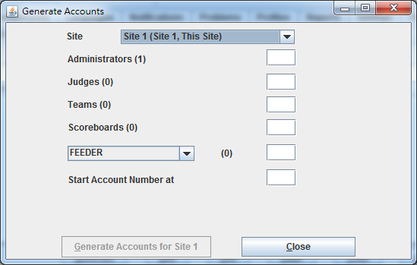
Administrator
Account
Number

Slide 21
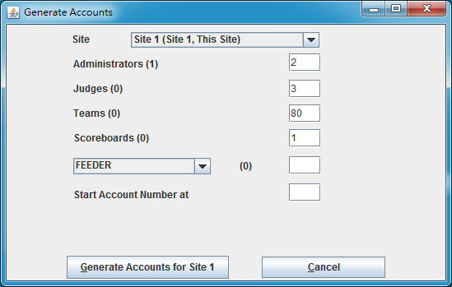
Administrator
Generate Accounts for Site 1

Slide 22
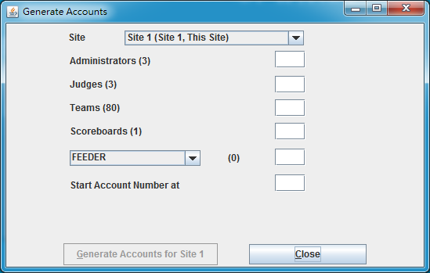
Administrator
Check the number of account

Slide 23
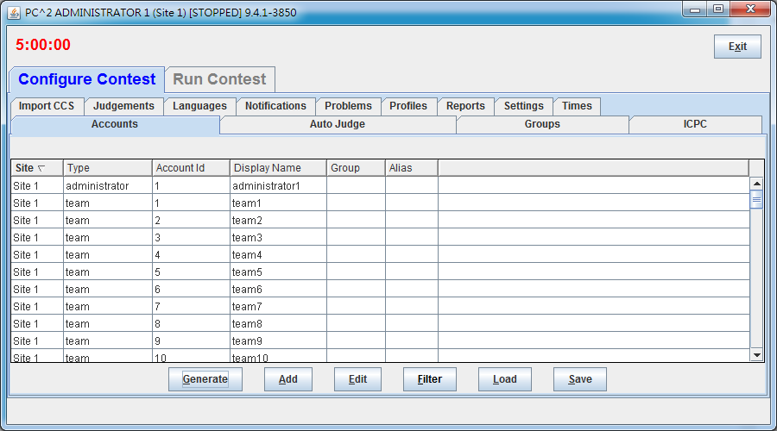
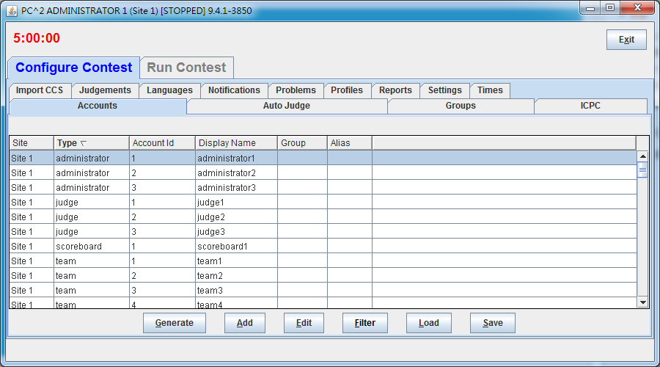
Administrator
Edit account

Slide 24
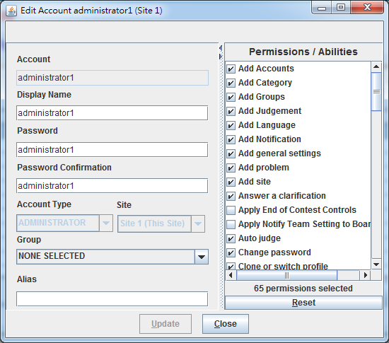
Administrator
Account : 帳號(不可改)
Display Name : 顯示名稱
Password :密碼

Slide 25
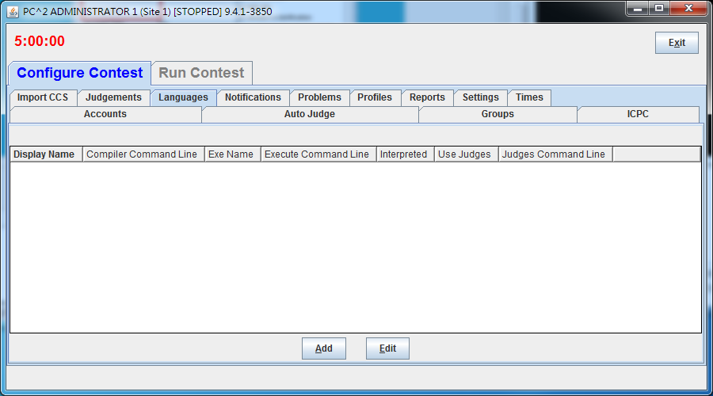
Administrator
New Languages

Slide 26
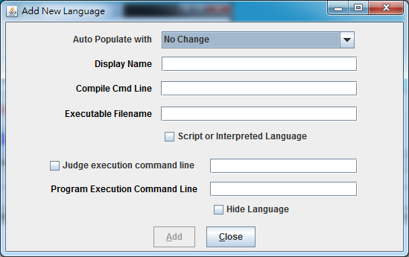
Administrator
Choose Language

Slide 27
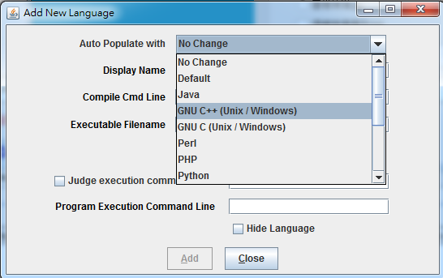
Administrator
Example : GNU C++ (Need C++ Compiler)

Slide 28
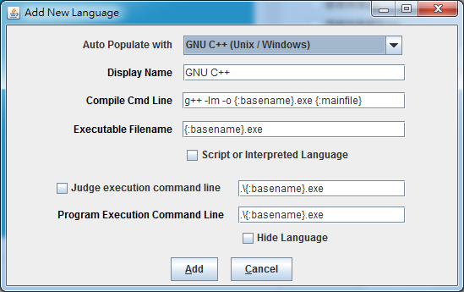
Administrator
Add Language

Slide 29
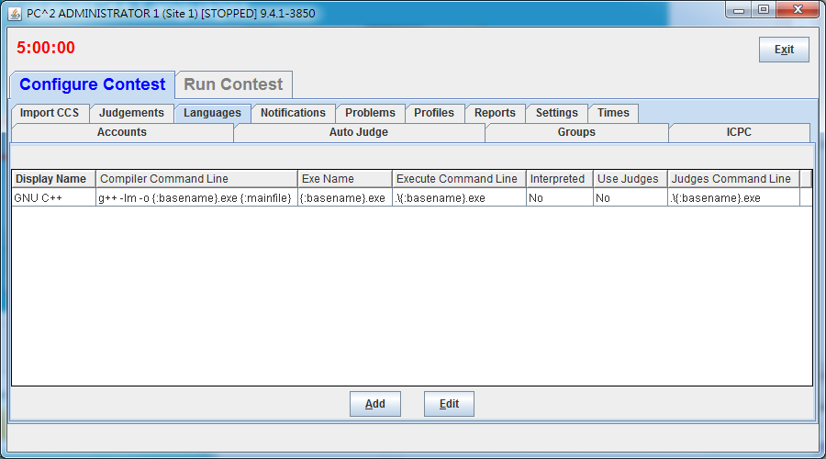
Administrator
C++ is added to contest

Slide 30
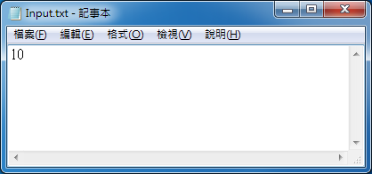
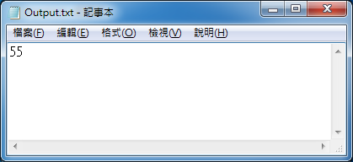
Administrator
例題 : 求出第n個費伯納西數列的數字( F(0)=F(1)=1 )
輸入一個整數n(n>0)
輸出費伯納西數列的第n位
Sample Input | Sample Output
10 | 55

Slide 31
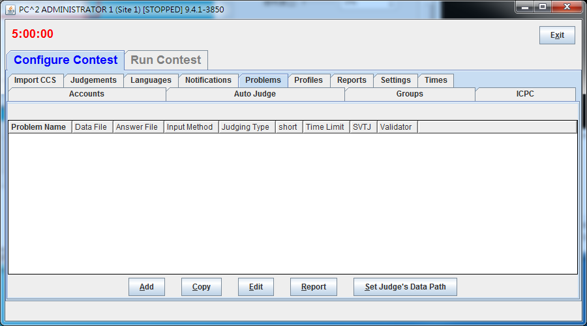
Administrator
選擇Problems，按下Add

Slide 32
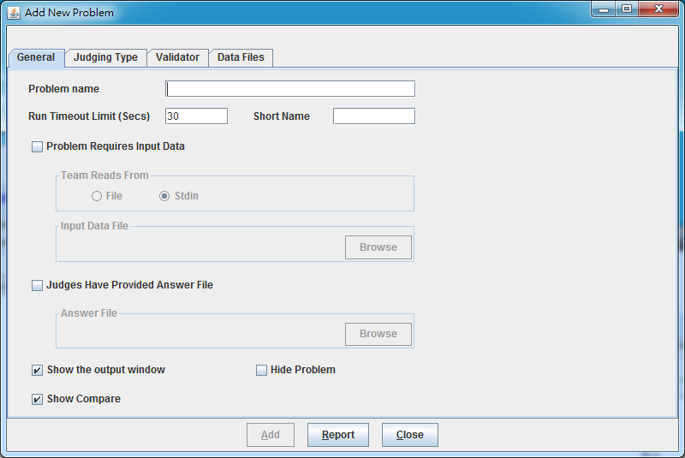
Administrator
輸入Problem name

Slide 33
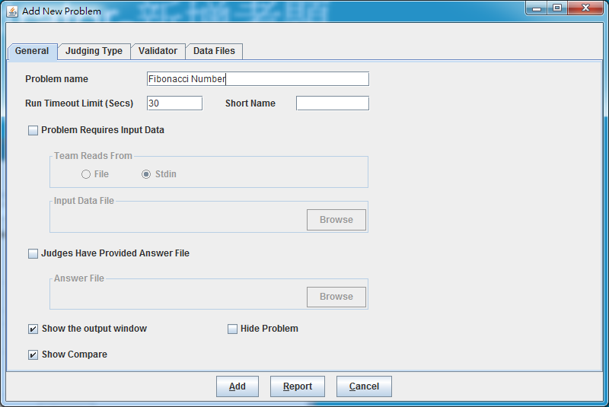
Administrator
Check Problem Requires Input Data / Judges … Answer File

Slide 34
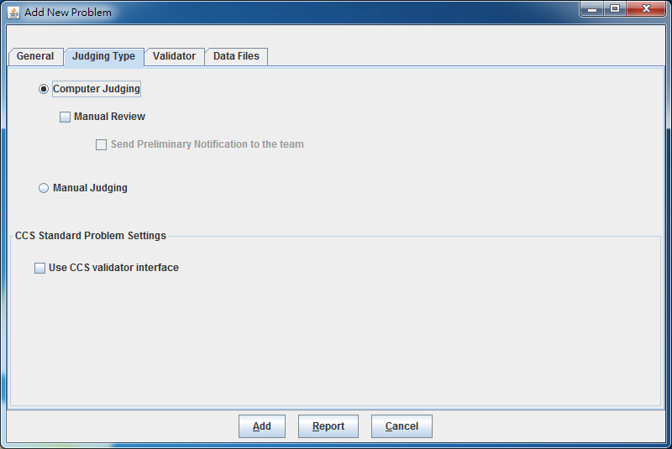
Administrator
Choose computer judging

Slide 35
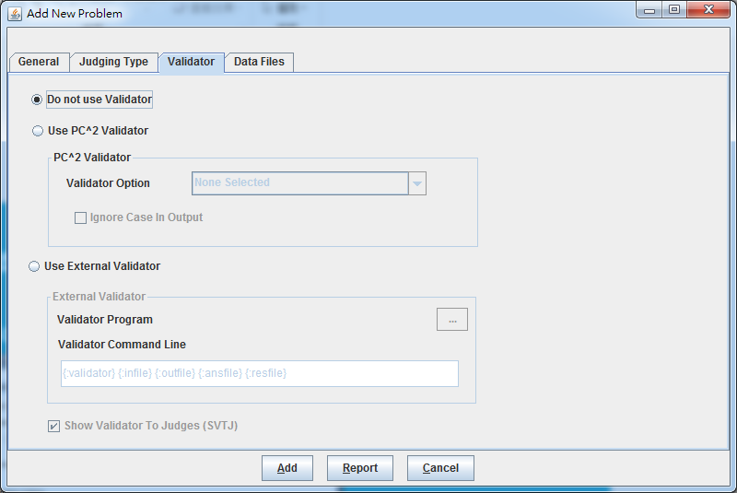
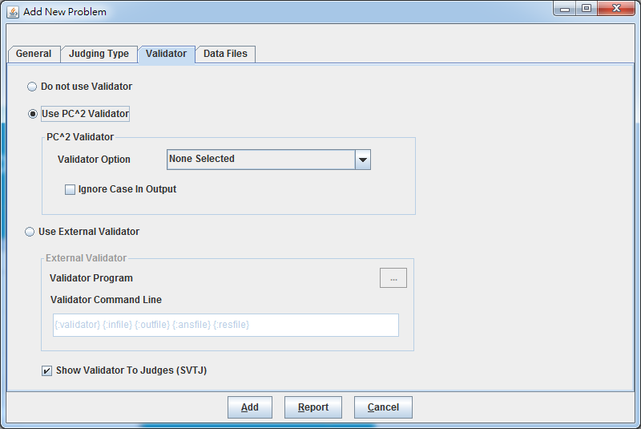
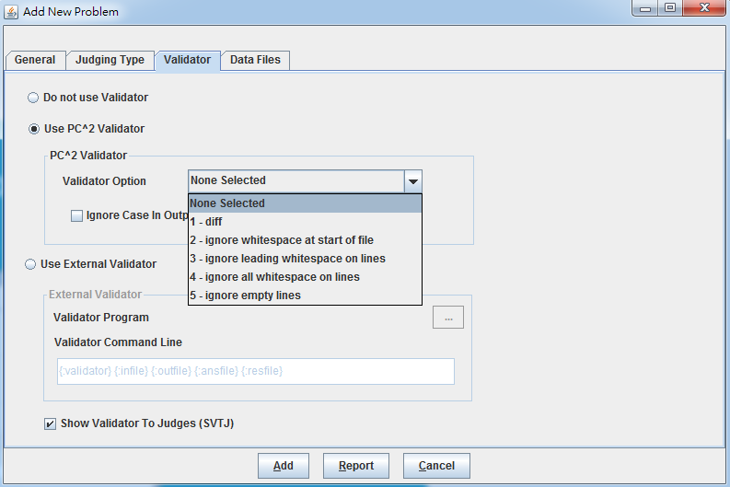
Administrator
Set Validator

Slide 36
Administrator
Validator Option
Option | Description
1. diff | 與Answer完全相同
2. Ignore whitespace at start of file | 忽略檔案最前頭的空白
3. Ignore leading whitespace on lines | 忽略每一行前面的空白
4. Ignore all whitespace on lines | 忽略所有的空白
5. Ignore empty lines | 忽略換行

Slide 37
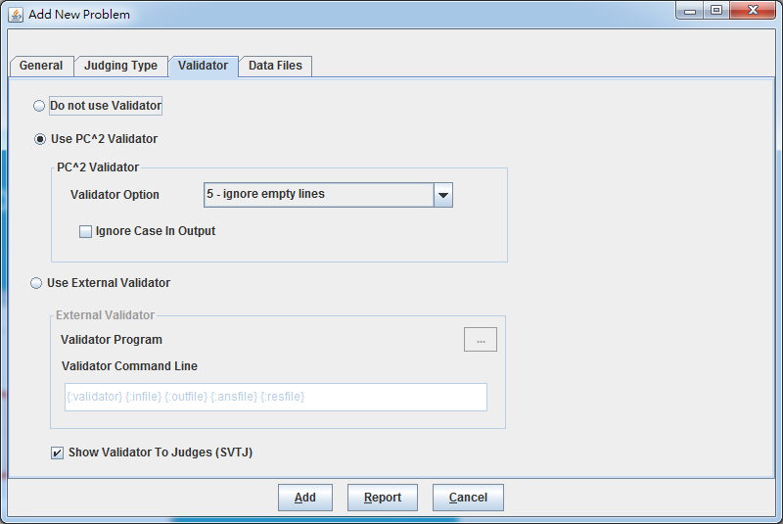
Administrator
Add Problem

Slide 38
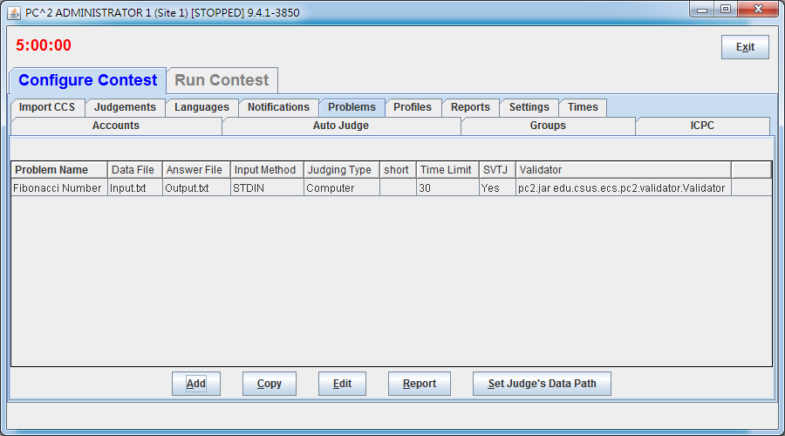
Administrator
Done

Slide 39
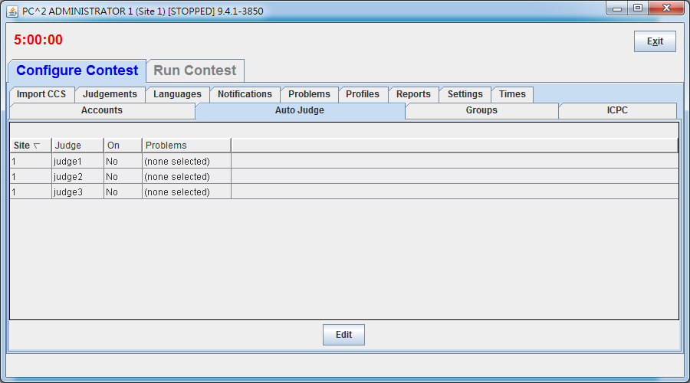
Administrator
Auto Judge

Slide 40
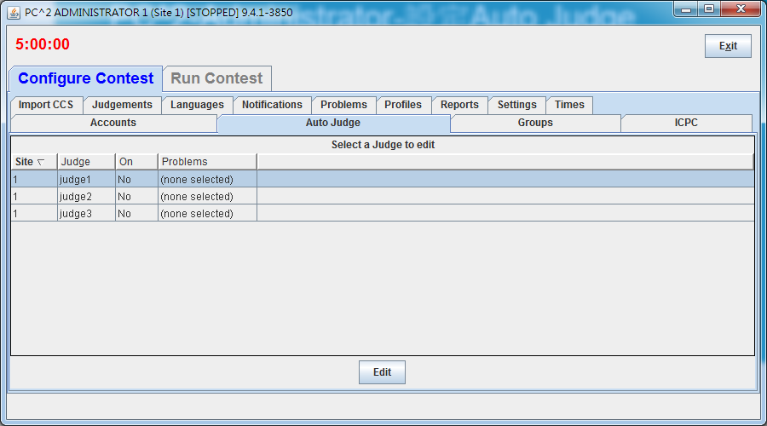
Administrator
Select a judge, Edit

Slide 41
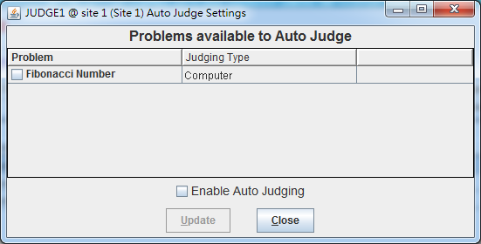
Administrator
選擇題目，按下Enable Auto Judging

Slide 42
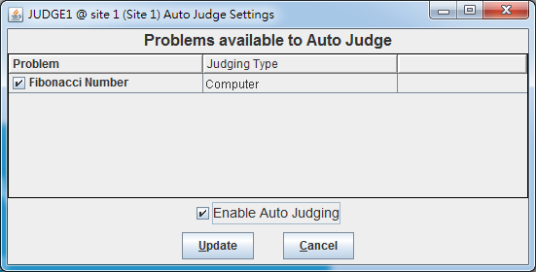
Administrator
Update

Slide 43
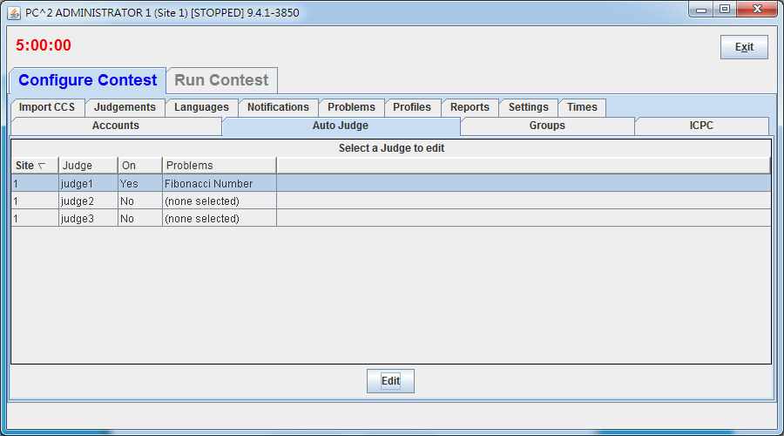
Administrator
完成設定自動批改

Slide 44
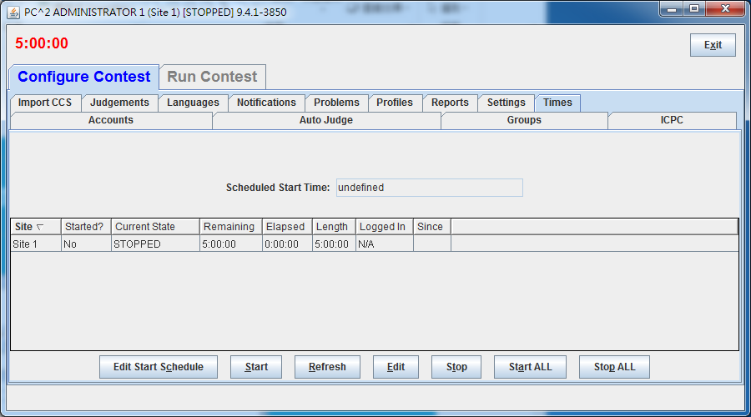
Administrator
Set contest times

Slide 45
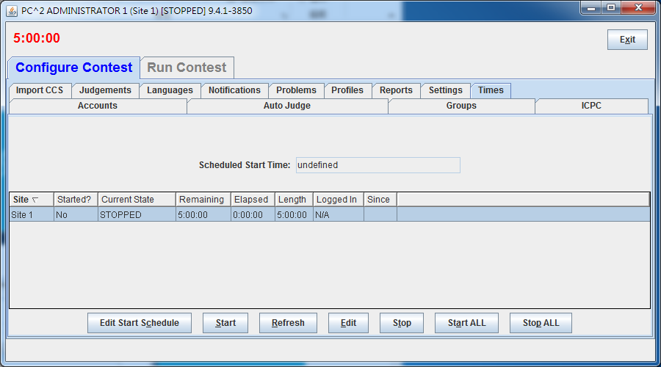
Administrator
Select a site, Edit

Slide 46
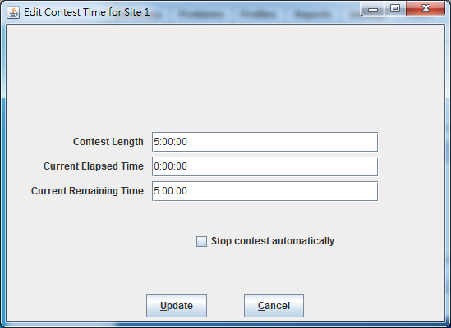
Administrator
輸入考試時間，Update

Slide 47
Administrator
Select Site 1, Start

Slide 48

Administrator
Start the contest

Slide 49
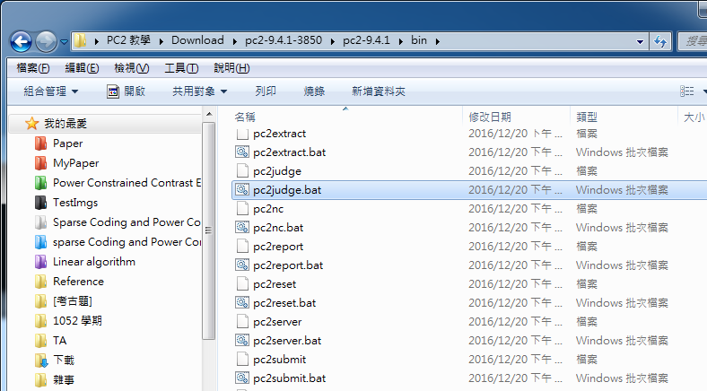
Judge
Windows : Double click pc2judge.bat
Linux : sh pc2judge

Slide 50
Administrator
Default Name : judge1 Passwd : judge1

Slide 51
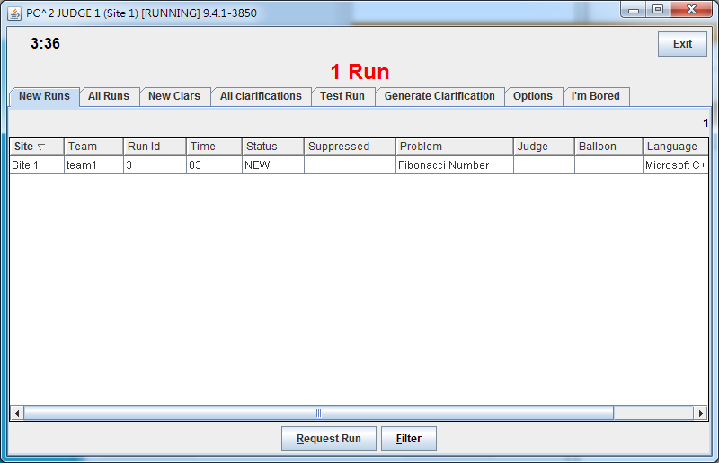
Judge
New Runs查看最新學生上傳內容

Slide 52
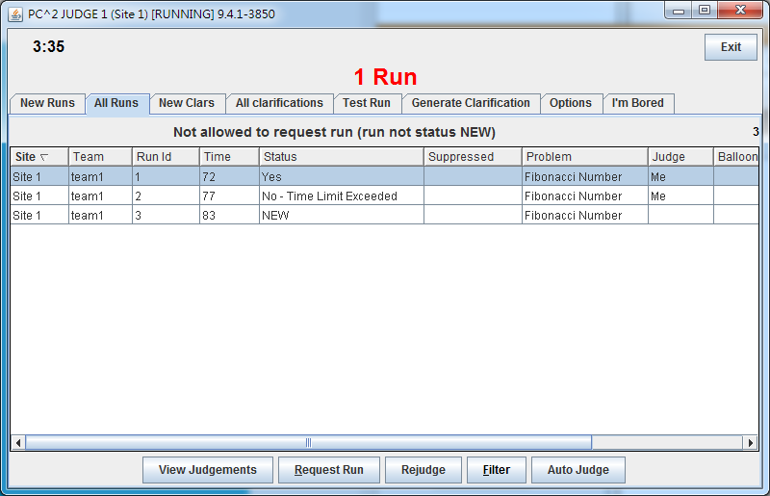
Judge
ALL Runs查看所有上傳

Slide 53
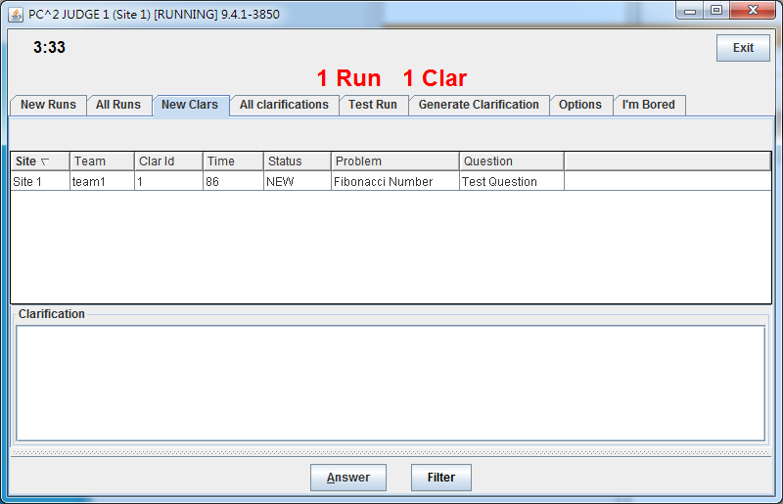
Judge
New Clars查看最新request clarification

Slide 54
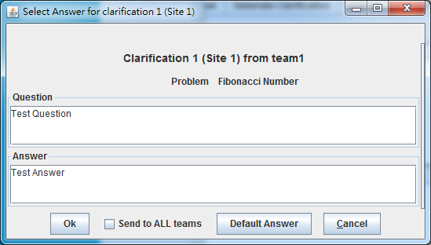
Judge
按下Answer回應Request

Slide 55
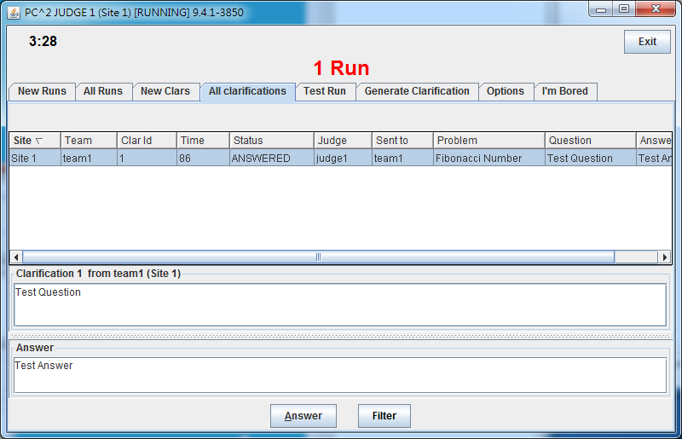
Judge
All Clarification查看所有request clarification
All Clarification查看所有request clarification

Slide 56
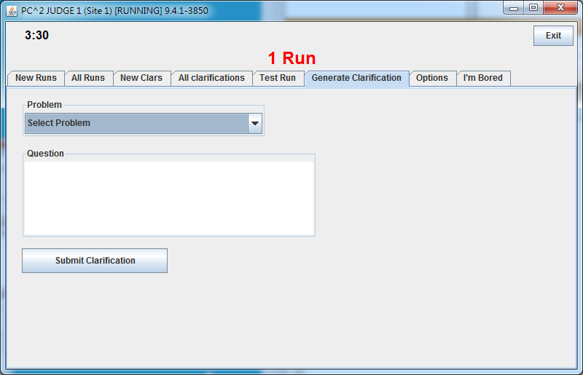
Judge
Generate Clarification可以新增題目說明
All Clarification查看所有request clarification

Slide 57
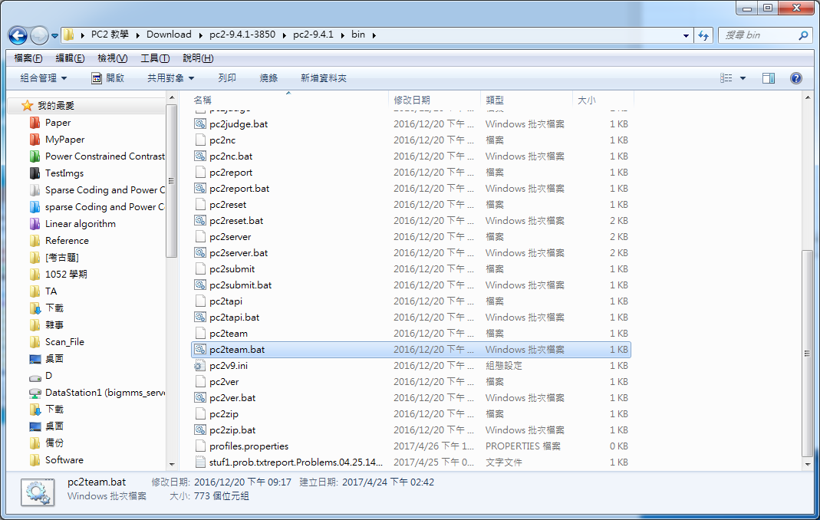
Team
Windows : Double click pc2team.bat
Linux : sh pc2team

Slide 58
Administrator
Default Name : team1 Passwd : team1

Slide 59

Team
Choose problem and Language

Slide 60

Team
Select answer code, Submit

Slide 61

Team
Confirm submission

Slide 62

Team
Confirm of run receipt

Slide 63

Team
若答案正確，則會跳出綠色Judge’s Response: Yes訊息

Slide 64



Team
其他Judge Response

Slide 65

Team
按下View Runs查看上傳記錄

Slide 66

Team
按下Request Clarifications，向Judge題出問題。

Slide 67

Team
按下View Clarifications，查看所有Clarification。

Slide 68
Scoreboard
Windows : Double click pc2board.bat
Linux : sh pc2board

Slide 69
Administrator
Default Name : scoreboard1 Passwd : scoreboard1

Slide 70
Scoreboard

Slide 71

Scoreboard
查看所有Team帳號的答題記錄

Slide 72

Scoreboard
cd /bin/html/

Slide 73

Scoreboard
Double check index.html

Slide 74

Scoreboard
Show the scoreboard

Slide 75
Scoreboard
Share html folder to apache2
sudo ln -s /home/USER_NAME/Desktop/pc2-9.4.1/bin/html /var/www

